Slide 1

Credit Card Fraud
Detection
MACHINE LEARNING CAPSTONE
An end-to-end, evidence-led machine learning workflow
DATA → SIGNAL → MODEL → DECISION

Slide 2
The goal is not just to classify — it is to reduce decision risk
A fraud model is a decision-support system with asymmetric error costs.
Catch more fraud
Protect good customers
Operate reliably
Prioritize recall while making missed-fraud risk explicit.
Control false alarms, declines, and manual-review workload.
Validate on untouched data and monitor changing behavior.
Machine-learning objective
Binary classification: y = 0 legitimate | y = 1 fraudulent

Slide 3
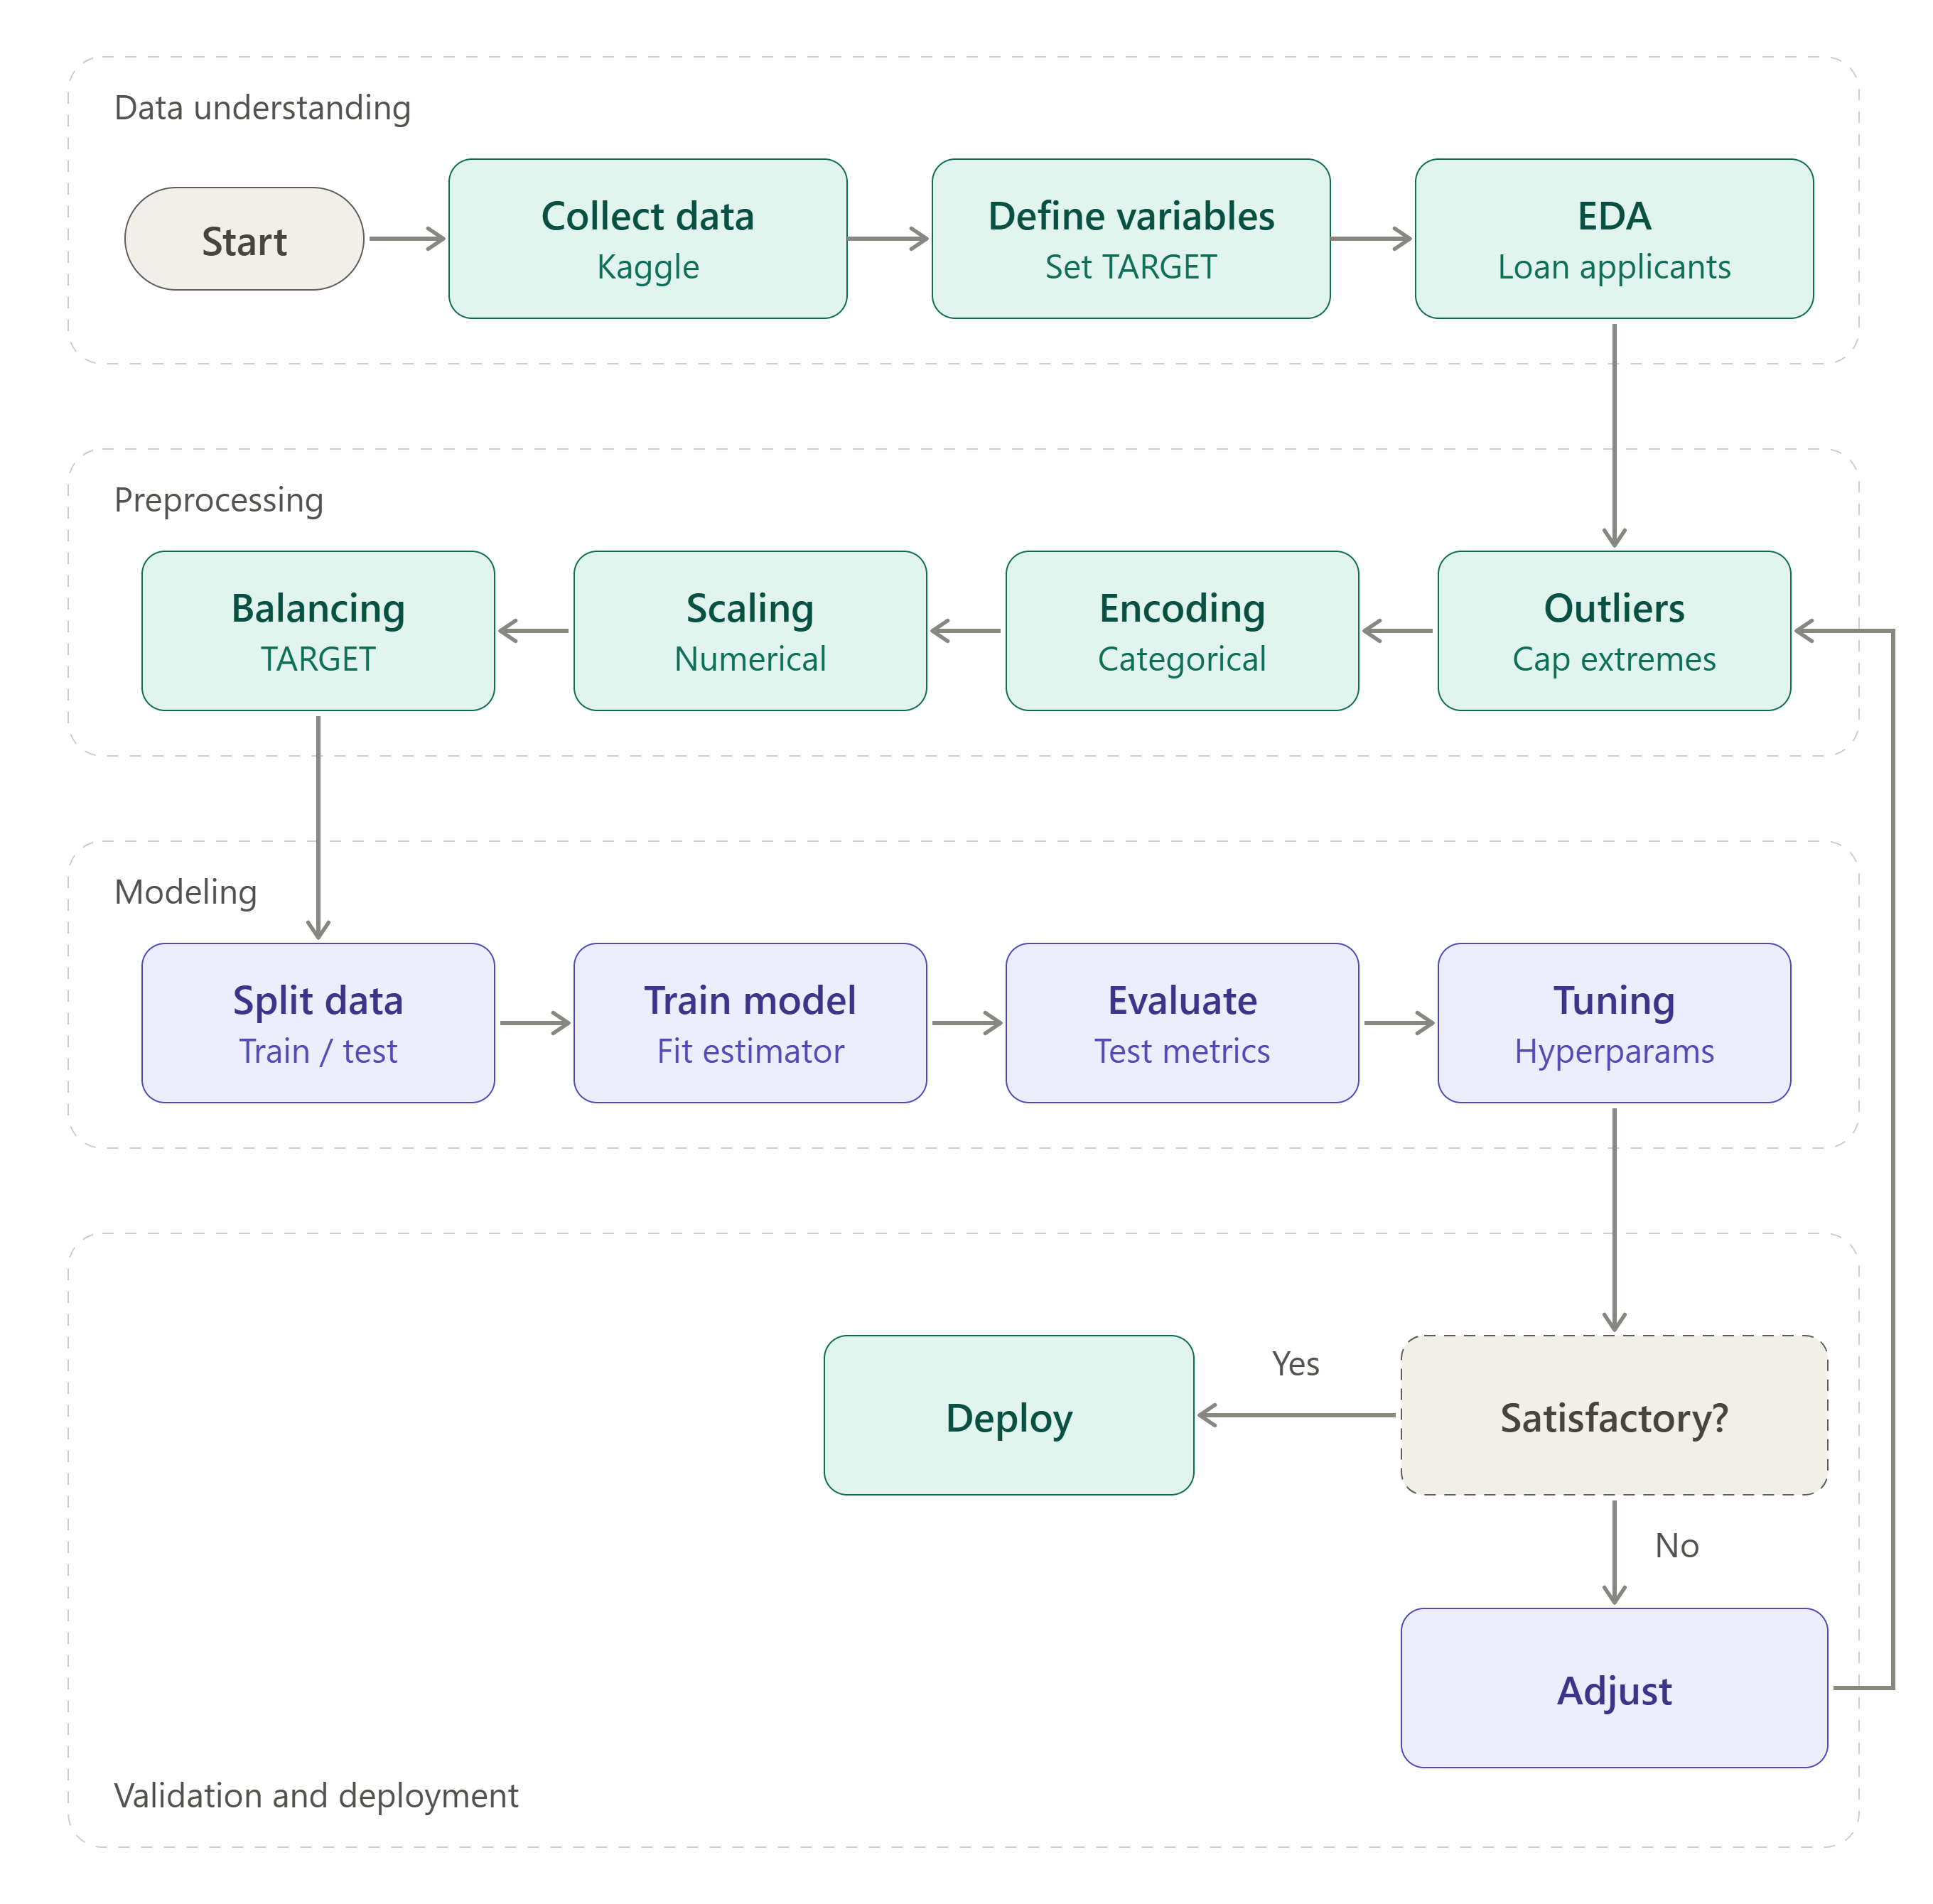
Flowchart as a snake layout

Slide 4
Data quality audit: decisions must follow evidence
Missingness
Duplicates
Per-column count: inspect whether missingness carries signal.
Exact-row duplicates vs repeated transactions: investigate before removal.
Types & ranges
Target Integrity
Validate timestamps, amount units, IDs, flags, and impossible values.
Confirm label meaning, class counts, label noise, and label timing
Leakage checks
Privacy & bias
Remove post-transaction outcomes, chargeback fields, and identifiers that encode labels.
Minimize sensitive data; inspect representation and subgroup error rates

Slide 5
EDA: three questions before choosing a model
Actual fraud count, legitimate count, and fraud rate. Interpret the baseline and class imbalance.
Compare amount distributions by class; use log scale / robust summaries if skewed.
Inspect distributions and correlations; describe association, not causation.
01 · Fraud prevalence
02 · Amount behavior
03 · Feature signal
EDA finding template: observation → quantitative evidence → operational implication → limitation.

Slide 6
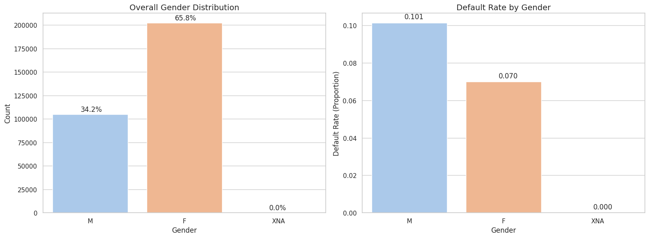
Gender Distribution and Default Risk Analysis
Gender Distribution: Female applicants represent the majority (65.8%), while male applicants account for 34.2%. The XNA category is negligible.
Default Rate by Gender: Male applicants exhibit a higher default rate of 10.1%, compared with 7.0% among female applicants.
Key Insight: Male applicants show a 3.1 percentage-point higher default rate, indicating a potential association between gender and loan repayment behavior.
Business Implication: Gender may be useful as an exploratory feature in credit risk analysis, but its predictive value should be validated statistically and assessed for fairness before model deployment.

Slide 7
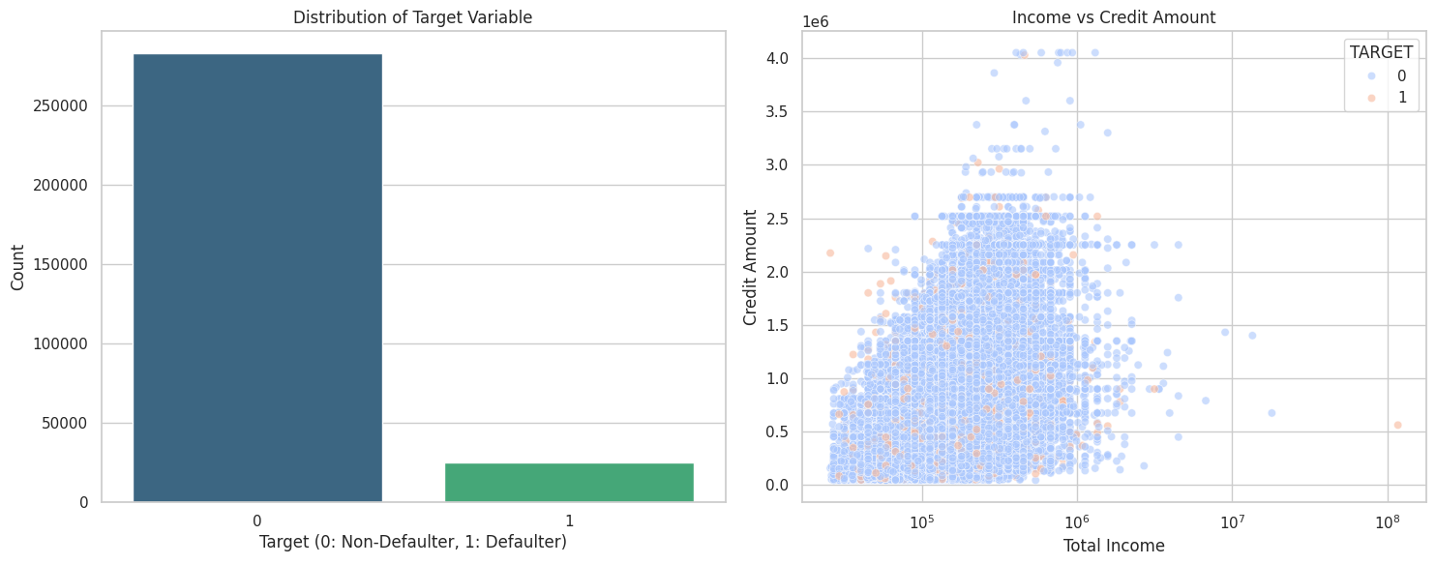
Target Distribution and Income vs. Credit Amount Analysis
Target Distribution: The dataset exhibits a significant class imbalance, with non-defaulters (TARGET = 0) substantially outnumbering defaulters (TARGET = 1).
Income vs. Credit Amount: Applicants with higher total income generally tend to have access to larger credit amounts, although the relationship shows considerable variability.
Default Patterns: Defaulters and non-defaulters overlap extensively across income and credit ranges, indicating that these two variables alone may not reliably distinguish default risk.
Outlier Detection: A small number of applicants exhibit exceptionally high income or credit values, warranting further investigation during data preprocessing.

Slide 8
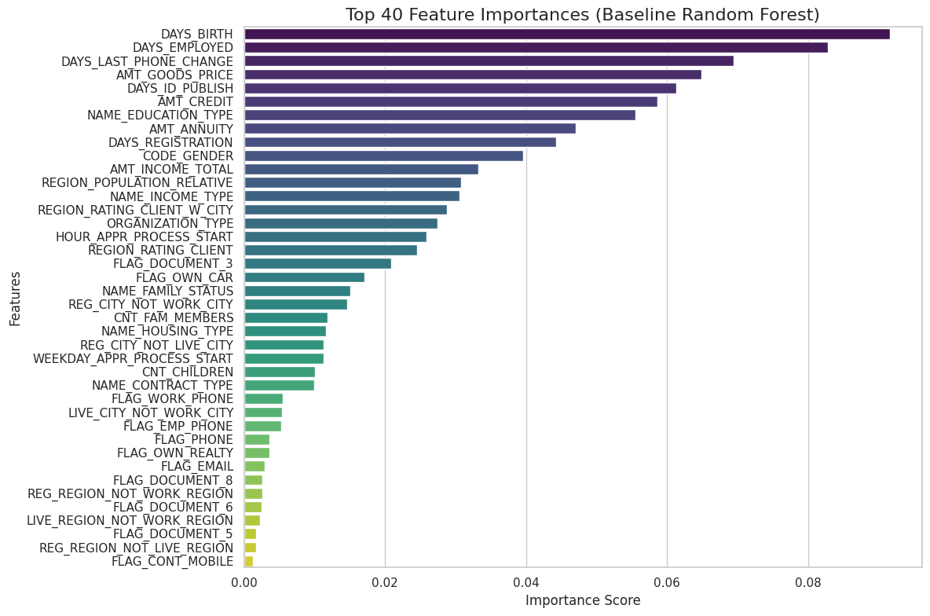
Top 40 Feature Importance Analysis — Baseline Random Forest

Slide 9
Top 40 Feature Importance Analysis
Top Predictive Features: DAYS_BIRTH, DAYS_EMPLOYED, and DAYS_LAST_PHONE_CHANGE are the most influential features in the baseline Random Forest model.
Financial Indicators: AMT_GOODS_PRICE, AMT_CREDIT, AMT_ANNUITY, and AMT_INCOME_TOTAL contribute substantially to the model's predictions.
Applicant Profile: Education type, gender, family status, housing type, and regional characteristics also contribute to predictive performance.
Lower-Ranked Features: Several binary indicators, including document flags and mobile contact status, have relatively low importance scores.
Key ML Insight: The model relies on a combination of demographic, employment, financial, and behavioral features to predict loan default.
Takeaway: Applicant age and employment-related information dominate the baseline model's feature importance rankings, while financial variables provide additional predictive signals.

Slide 10
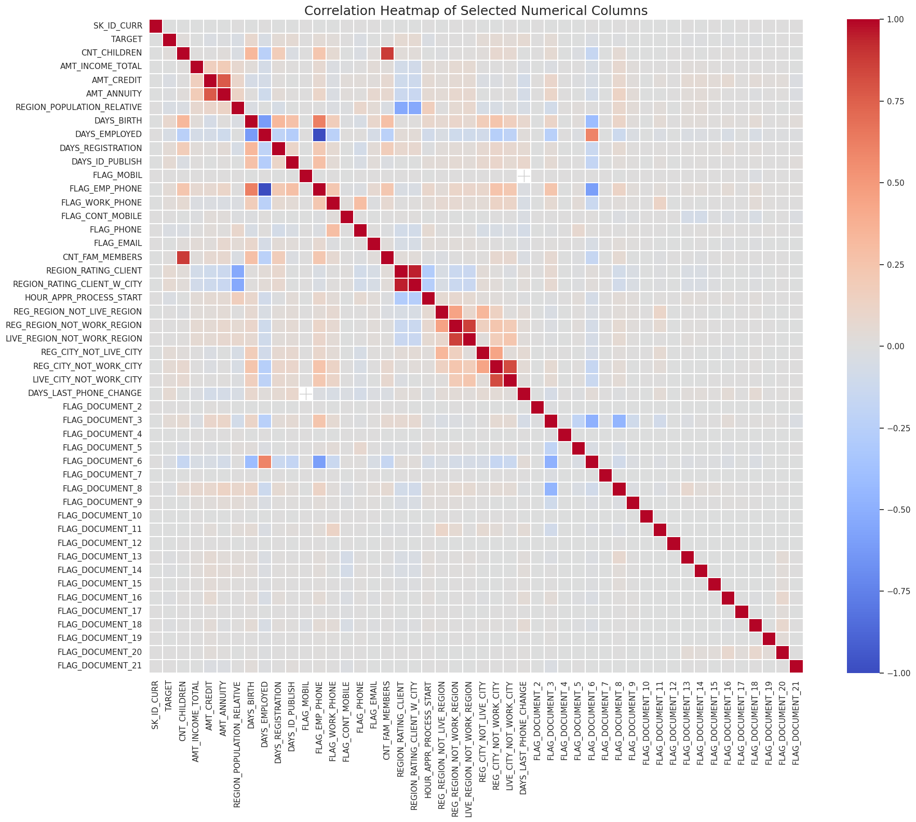

Slide 11
Correlation Analysis of Selected Numerical Features
Strong Financial Correlation: AMT_CREDIT and AMT_ANNUITY exhibit a strong positive correlation, indicating that larger credit amounts tend to be associated with higher loan repayment obligations.
Demographic Relationships: CNT_CHILDREN and CNT_FAM_MEMBERS show a strong positive correlation, reflecting the relationship between the number of children and household size.
Employment and Age: DAYS_BIRTH and DAYS_EMPLOYED show a notable relationship, suggesting that applicant age and employment history are associated.
Regional Feature Correlations: Several regional indicators demonstrate moderate to strong correlations, potentially reflecting overlapping geographic information.
Target Variable: TARGET shows mostly weak linear correlations with individual numerical features, suggesting that loan default prediction may require combining multiple features and capturing nonlinear relationships.
Multicollinearity Check: Strongly correlated predictors should be examined before model development, particularly when using models sensitive to multicollinearity.

Slide 12
Visualization plan: each chart answers one decision question
Keep axes, class labels, units, and interpretation visible.
Class Balance.
How rare is fraud?
Counts + %; actual dataset
Correlation Heatmap.
Which numeric signals co-vary?
Numeric features only
Feature Distributions.
Which features differ?
Split by target class

Slide 13
Class imbalance: the majority class can hide failure
Only label the problem 'highly imbalanced' after calculating the target distribution.
Class weights, random sampling, SMOTE, threshold adjustment; compare empirically.
Resampling only on training folds. Keep validation and test prevalence natural.
Why accuracy can mislead
Candidate strategies
Leakage rule
A model predicting every transaction as legitimate can score highly when fraud is rare.
Recommended comparison
Baseline with no resampling
Class-weighted model
Training-only resampling in a pipeline, if justified
Thresholds selected on validation data against business costs
Using simple imputer

Slide 14
Metrics that reflect the cost of fraud decisions
Use fraud = positive class; report threshold-dependent and threshold-independent metrics.
Precision
Recall/sensitivity
TP / (TP + FP)
TP / (TP + FN)
Of alerts, how many are fraud?
What share of fraud was caught?
F1-score
Accuracy
2PR / (P + R)
TP+TN / (TP+TN+FP+FN)
Harmonic mean of precision and recall.
Model overall accuracy.
FPN
FNR
FP / (FP + TN)
FN / (FN + TP)
Legitimate transactions incorrectly flagged.
Fraudulent transactions missed.

Slide 15
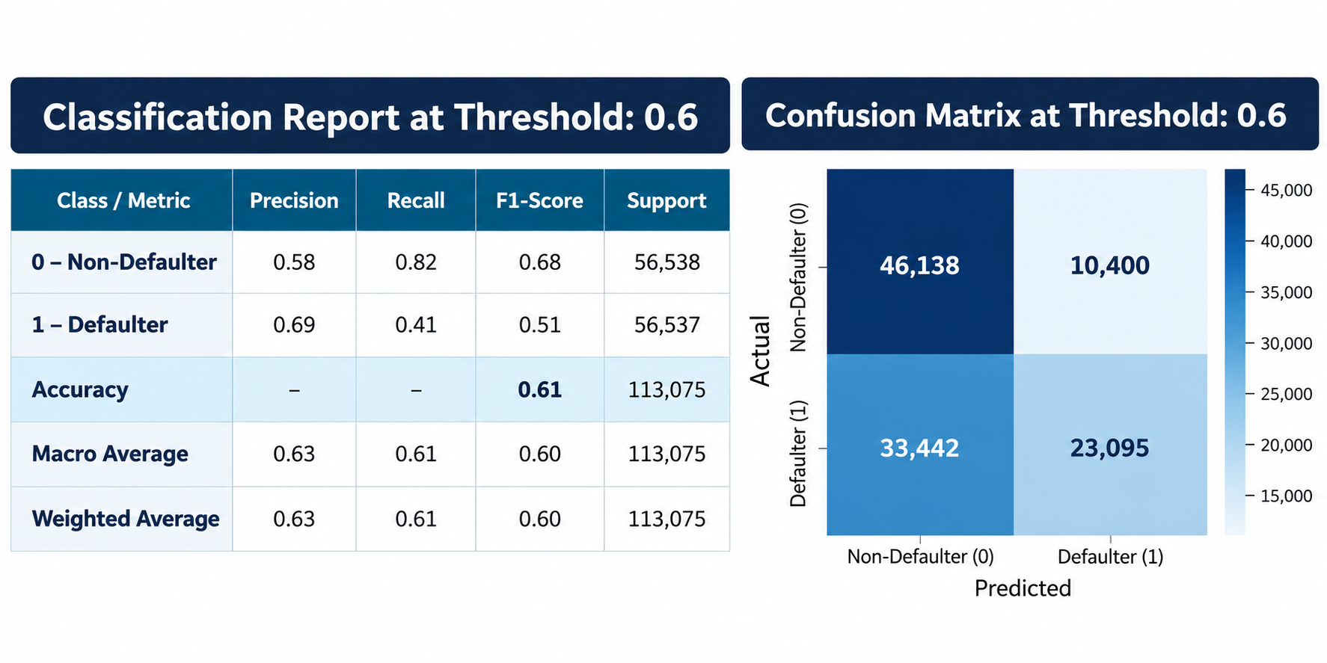
Logistic Regression Model
Why did you choose Logistic Regression as your baseline model?
Logistic Regression is a simple, computationally efficient, and interpretable classification algorithm. It estimates the probability of default, which is particularly useful in credit risk assessment.
I used it as a baseline to establish a benchmark performance against which I could evaluate more complex models, such as Random Forest and XGBoost. This allowed me to determine whether the additional complexity of ensemble models resulted in meaningful improvements in predictive performance.

Slide 16
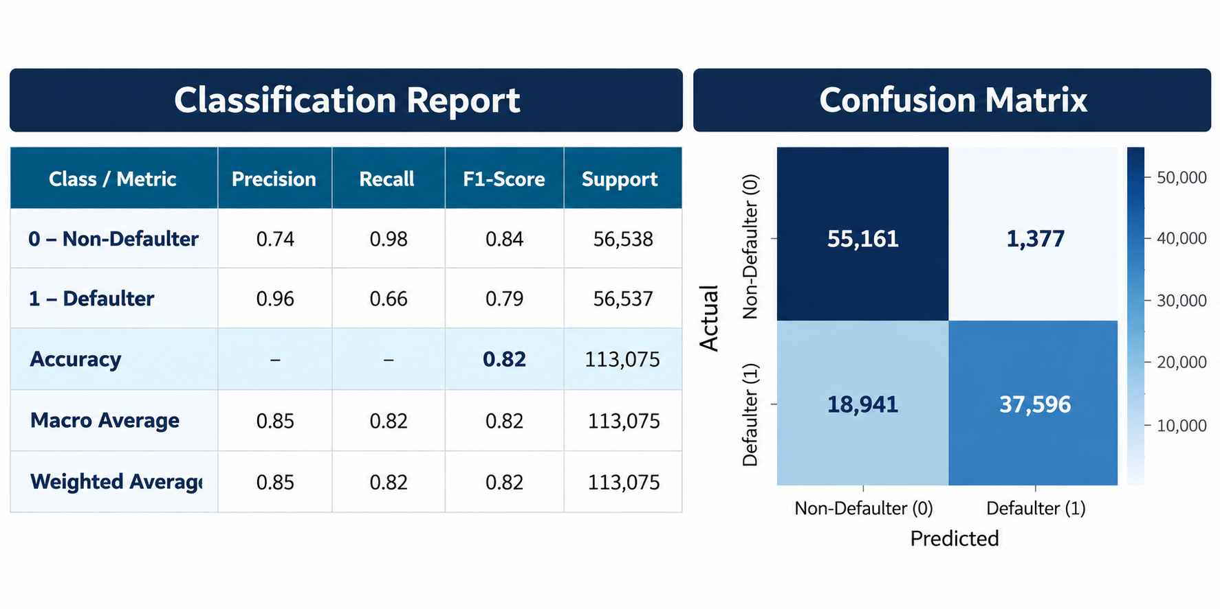
Random Forest Model

Slide 17
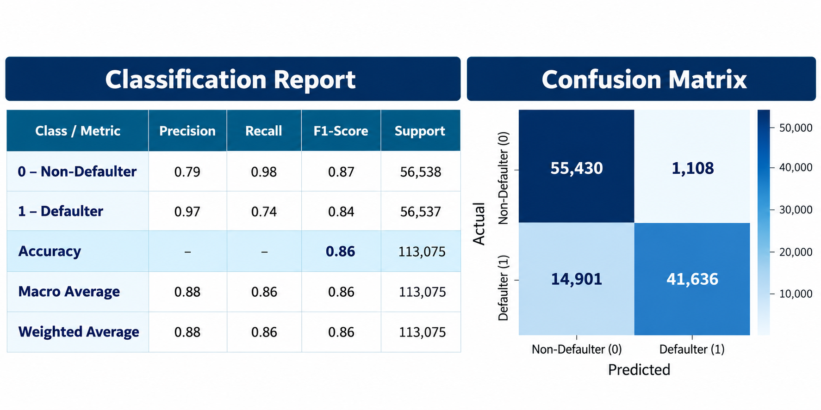
Hyperparameter tuning is the process of finding the best configuration of a machine learning model before or during training so that it performs well on unseen data. After applying hyperparameters to RF model.

Slide 18
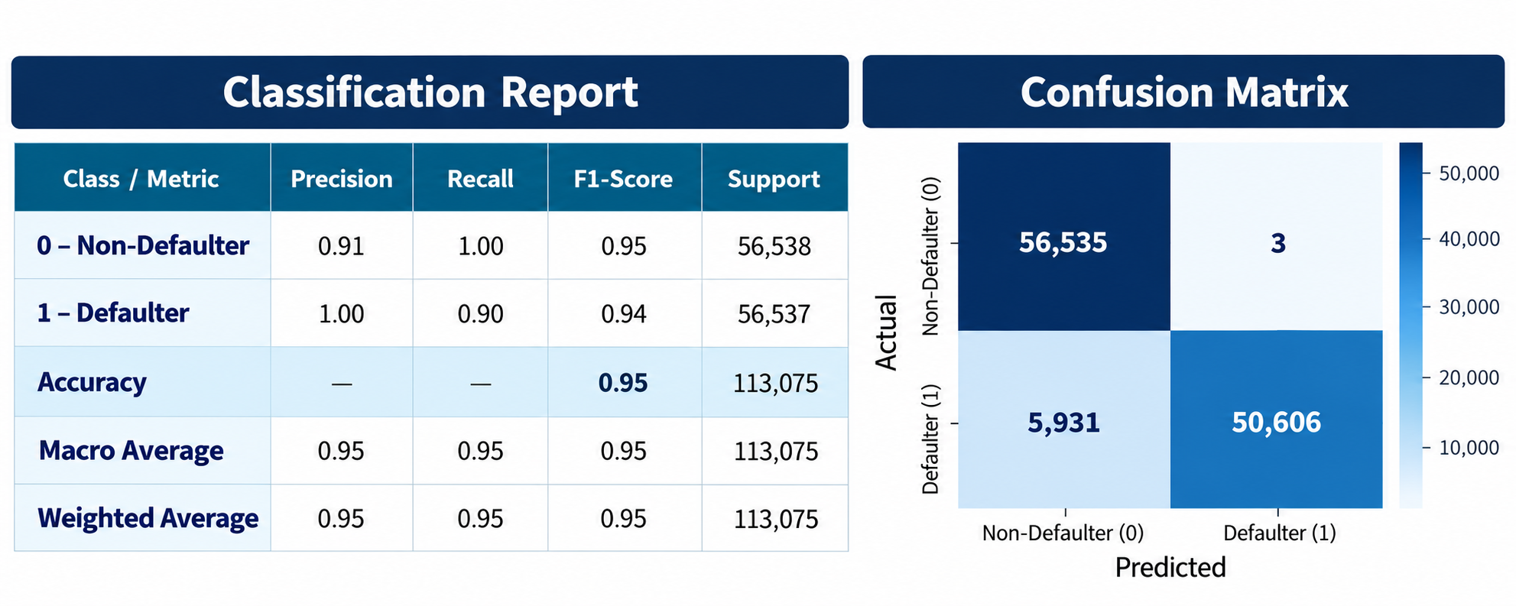
XGboost Model

Slide 19
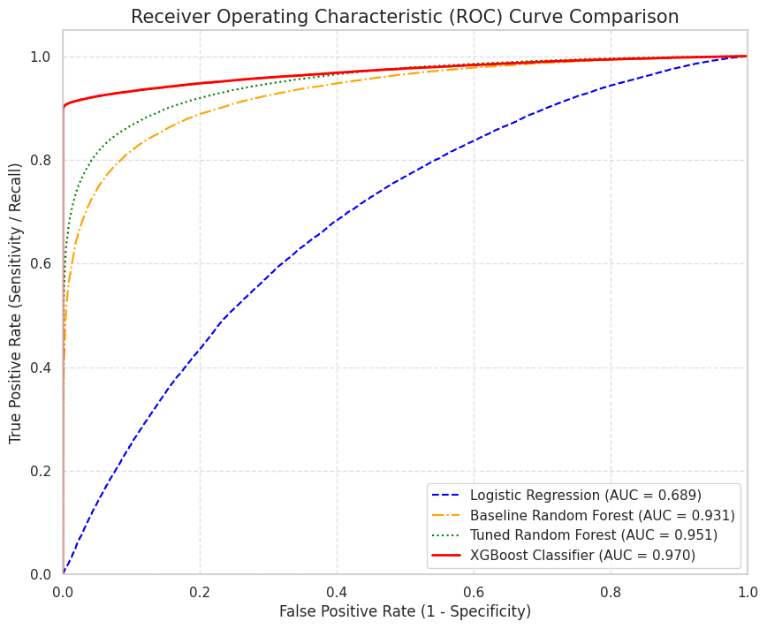
An ROC curve is a graph used to evaluate a binary classification model by plotting:
X-axis: False Positive Rate (FPR) — the proportion of actual non-defaulters incorrectly predicted as defaulters.
Y-axis: True Positive Rate (TPR) — the proportion of actual defaulters correctly identified by the model. This is also called recall or sensitivity for the default class

Slide 20
Conclusion — Credit Default Risk Prediction
Comprehensive Risk Assessment: The project explored demographic, financial, employment, and behavioral variables to identify patterns associated with loan default.
Data-Driven Modeling: Logistic Regression established a baseline, while Random Forest, hyperparameter-tuned Random Forest, and XGBoost enabled comparison of more complex classification approaches.
Model Evaluation: Classification reports, confusion matrices, and ROC curves were used to evaluate predictive performance, including the ability to distinguish defaulters from non-defaulters.
Improved Default Detection: The evaluated models demonstrated different trade-offs between precision and recall, highlighting the importance of identifying potential defaulters while minimizing incorrect risk classifications.
Practical Application: The project provides a foundation for data-driven credit risk assessment, potentially helping lenders prioritize applications for further review and make more informed lending decisions.

